Slide 2
CONTENTS
problem statement and understanding
EDA steps and visualizations
Steps and assumptions used to complete the project
model dashboard
finalized model
conclusion.

Slide 3
Objective
A US-based housing company named Surprise Housing wants to enter Australian market and so the company is looking at prospective properties to buy to enter the market.
We are supposed to build a regression model using regularisation in order to predict the actual value of the prospective properties and decide whether to invest in them or not.

Slide 4
Problem statement
We are required to understand the big dataset and understand the variables effecting house prices
Predict the housing prices with those important attributes and maximum accuracy
Since we have 1460 columns with 81 variables with null values it is challenging to understand null columns and fill appropriate values.
Co-relation has to be made on complete dataset hence dividing and analyzing cannot be used as solution.

Slide 5
Understanding the columns
The dataset contains 80 coumns consisting of integer type,object type and float
Id column was first unique column which is similar to index so we deleted it
Since data contains Nan values and pictorial diagram we couldn’t recognize all the columns hence divided data into four equal sets df_train1, df_train2, df_train3, df_train4 and target column to predict sales price df_Target
All four data sets are analyzed separately, viewed categorical variables and numerical variables

Slide 6
Understanding the columns
These divided data helped treat nan values categorical items were replaced with string and numerical data with median and mode

Slide 7
EDA steps and Data visualization
Codes like dtypes, .info, null, msno.bar helped us understand the data
Found all unique items in each column
Replaced Nan items similar to those unique items in case categorical items
Numerical values were understood in csv file and treated them accordingly
Statistical tools – Describe and Correlation was used to understand the data distribution

Slide 8
Data visualization
In describe option we found MSSubClass, LotFrontage, LotArea, OverallCond, MasVnrArea, BsmtFinSF1, BsmtFinSF2, BsmtUnfSF, TotalBsmtSF, GarageYrBlt,1stFlrSF,2ndFlrS were the columns having high variations and data was not evenly spread.
Combined all divided dataset and understood their correlation between variables
Dropped 1stFlrSF, Garagearea, Totrmsabvgrd as this columns had comparatively high correlation
In bi variate analysis u nderstood the data distribution and outliers

Slide 9
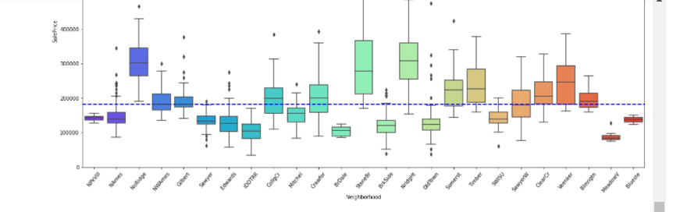

Slide 10
Data visualization
From bi variate analysis we could understand
We can observe MSSubClass having outliers are found in high in 20,50,60,80 & 120
MSZoning RL,RM LOTSHAPE IR1, Reg, IR2 Single Family is costlier in Building Type and Northridge is closer in Neighborhood place.
Gable Roofing with Standard (Composite) Shingle material is costlier comparatively.
Poured Contrete Foundation and Excellent Basement Quality and with condition Typical - slight dampness property is costlier

Slide 11
Data visualization
Central Air conditioned property with Standard Circuit Breakers & Romex and excellent kitchen Quality with max of 11 rooms house is costlier
Three Fire place and good garage with # cars parking area is costlier
Excellent heating Quality in Gas forced warm air furnace and Gas hot water or steam heat is higher.
Paved Driveway with excellent pool condition, properly fenced with Tennis Court month sold is 7 is very costly.
year sold at 2007 with sale deed type Warranty Deed - Conventional Home was not completed when last assessed is costlier in market.

Slide 12
Data preperation
Listed out all numerical and non numerical columns in two different categories
Since in zscore and quantile method outliers removing process huge data were lost we dint use removing outliers step
Dummies were used to categorical items
And joined both numerical and non numerical columns together and named it df_final which has 298 columns
Dropped original columns were dummies were created for non numerical items and got columns down to 255
Applied train test split
Standard scaler

Slide 13
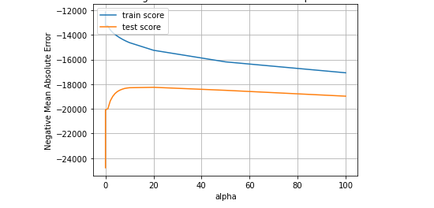
Model building
Used ridge and lasso regressors
GridsearchCV and found alpha 7 was the best cv
plottED mean test and train scores with alpha

Slide 14
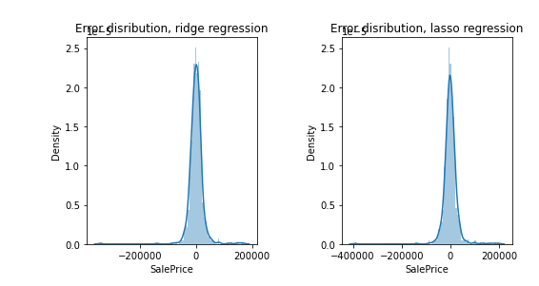
Conclusion
Understood error distribution in both models and both

Slide 15
Conclusion
Parameters and coefficient was derived for each model
Identified important features, excluding dummies
variables with positive and negative coefficients was observed separately
Again tested in lasso and ridge by doubling alpha value

Slide 16

Conclusion
Scores

Slide 17

Conclusion
After doubling alpha value score is

Slide 18
Conclusion
Found before doubling alpha the score predicted were best for the model and finalized it as best fit model

